Slide 1
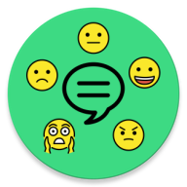
FeelChat: Automatic Recognition of The User’s Emotional State in One-to-One Chat
Francesco Iemma
Lorenzo Massagli
Niko Salamini
Olgerti Xhanej

Slide 2
FeelChat: Automatic Recognition of The User’s Emotional State in One-to-One Chat
Francesco Iemma
Lorenzo Massagli
Niko Salamini
Olgerti Xhanej

Slide 3

FeelChat: Automatic Recognition of The User’s Emotional State in One-to-One Chat
Francesco Iemma
Lorenzo Massagli
Niko Salamini
Olgerti Xhanej

Slide 4
TABLE OF CONTENTS
01
INTRODUCTION
02
APPLICATION
POWER CONSUMPTION ANALYSIS
03
04
MODEL ANALYSIS

Slide 5
01
INTRODUCTION

Slide 6
— Dr. John Campo (Director of the Division of Child and Adolescent Psychiatry at Johns Hopkins University School of Medicine)
“When mental health is ultimately recognized as essential to physical health, not an extraneous element of it, then we will have access to true, complete, modern medicine.”

Slide 7
APPLICATION FIELDS
Communication
Healtcare
Marketing

Slide 8
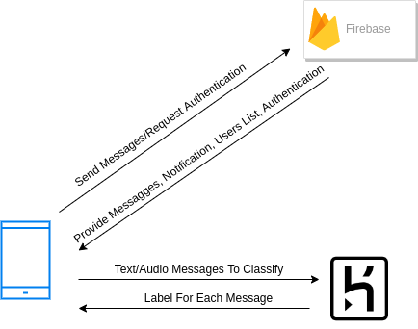
ARCHITECTURE
The System architecture is made up of:
Android Application
Firebase Realtime Database
Firebase Storage
REST Server on Heroku

Slide 9
TWO IMPORTANT CONCEPTS
User
Efficiency
Usability: User friendly GUI
Information on users’ emotional state
Low power consumption: the most of the computations are done on the server

Slide 10
02
APPLICATION

Slide 11
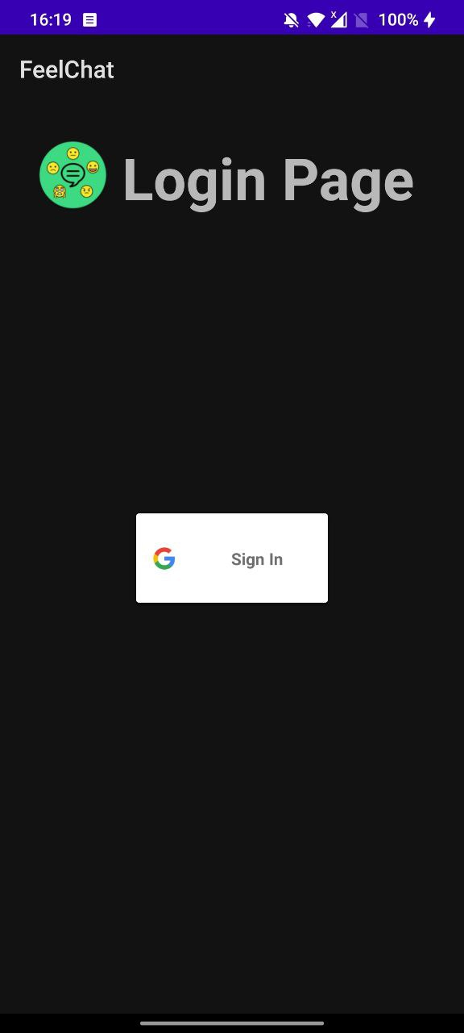
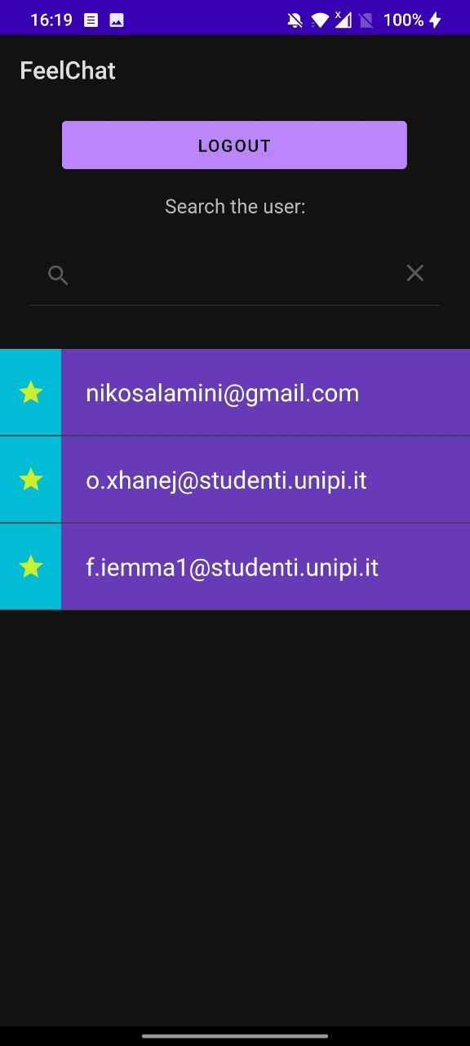
LOGIN & CONTACTS ACTIVITY
Login with Google OAuth
Favorites
Search by email

Slide 12
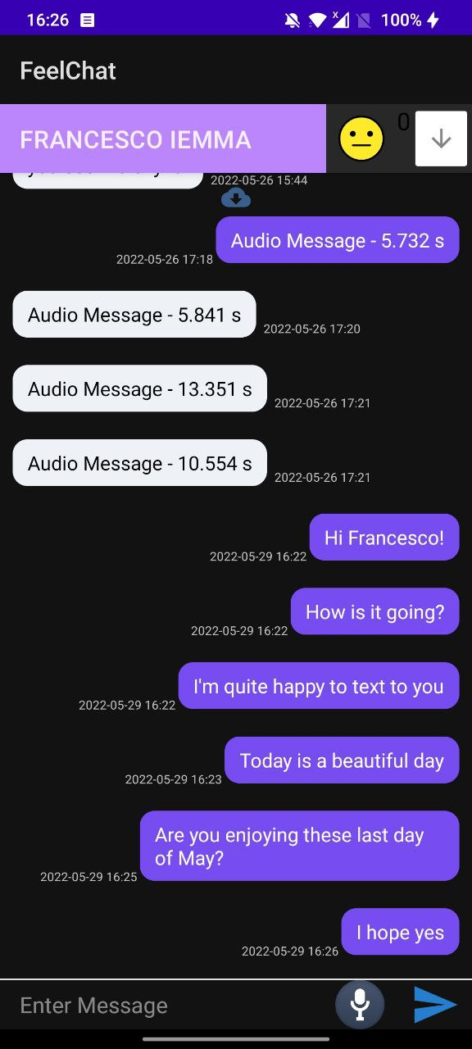
CHAT ACTIVITY
Text messages and Audio messages (WAV)
Message fetching windowed
Caching of Audio Messages
Notifications
Aggregated Emotion Classification

Slide 13
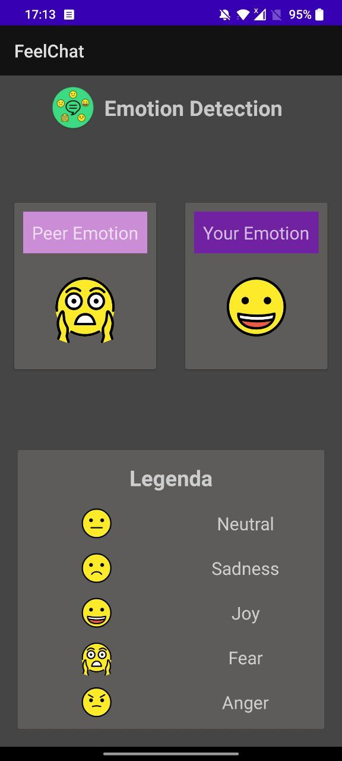
EMOTION ACTIVITY
A
A
T
T
T
T
T
A
T
A
T
T
5 Possible emotions
Classification by Sender
Current Emotion: Window of last block of 5 Messages
Aggregation policy: majority
classification
[joy, fear, neutral, joy, anger]
majority
joy

Slide 14
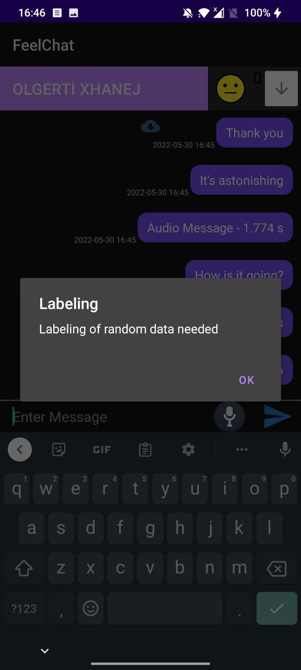
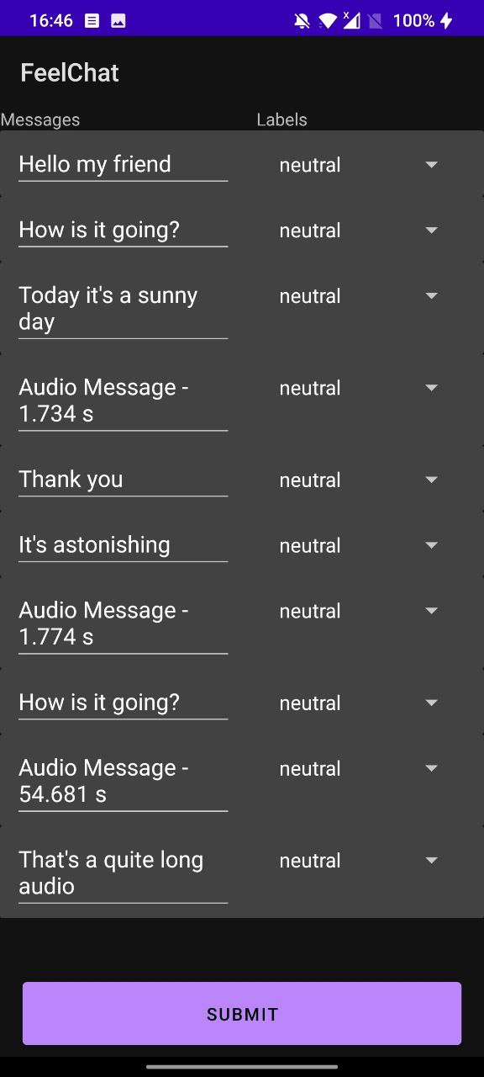
LABELING ACTIVITY
Participants need to carry out manual labeling
Neutral in case of uncertainty

Slide 15
03
MODEL ANALYSIS

Slide 16
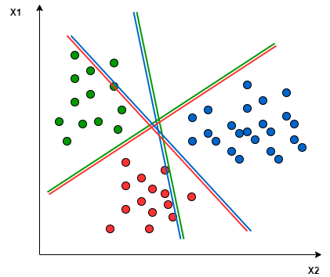
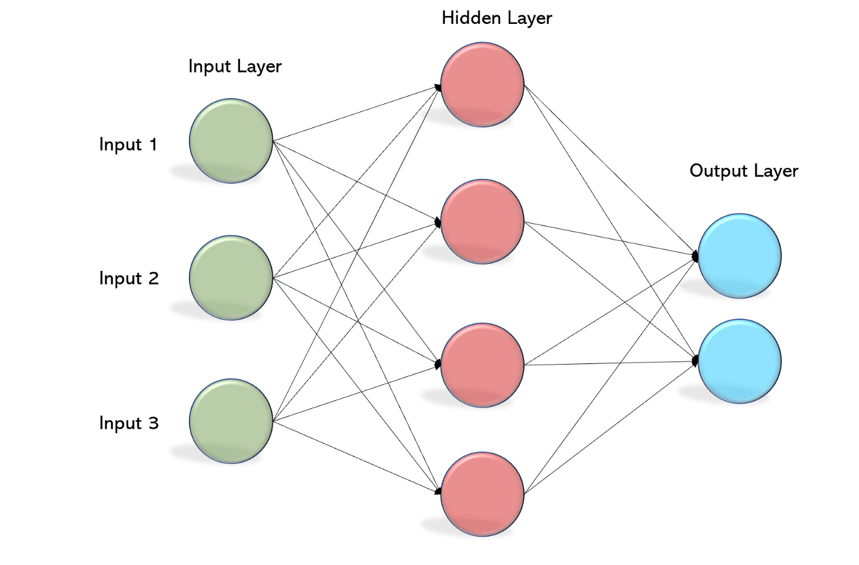
MODELS
Text Emotion Detection Model
Support Vector Machine (SVM)
WASSA Dataset
Text cleaning + TF-IDF
Audio Emotion Detection Model
Multilayer Perceptron (MLP)
RAVDESS + TESS + EMODB Datasets
Feature Extraction: MFCC

Slide 17
TEXT EMOTION DETECTION MODEL
 | WASSA + USER (train and test) | WASSA (train and test) | USER (train and test) | WASSA (train) + User (test)
Accuracy | 0.51 | 0.84 | 0.64 | 0.38
Precision | 0.52 | 0.84 | 0.59 | 0.50
Recall | 0.46 | 0.83 | 0.60 | 0.38
F1_score | 0.47 | 0.84 | 0.59 | 0.38

Slide 18
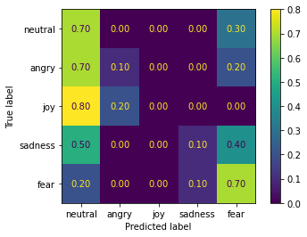
AUDIO EMOTION DETECTION MODEL
Dataset = TESS + RAVDESS + EMO-DB
 | Dataset (train and test) | Dataset (train) and User (test)
Accuracy | 0.78 | 0.38

Slide 19
04
POWER CONSUMPTION ANALYSIS

Slide 20
About the Experiments
The experiments consists in automating a common usage of the application with an adb command script:
The chat was reloaded every 15 seconds in a window of 20 minutes
Device screen brightness fixed for the entire experiment
Caching of audio images disabled
Devices connected via WiFi
Battery historian tool to analyze the results of each experiment

Slide 21
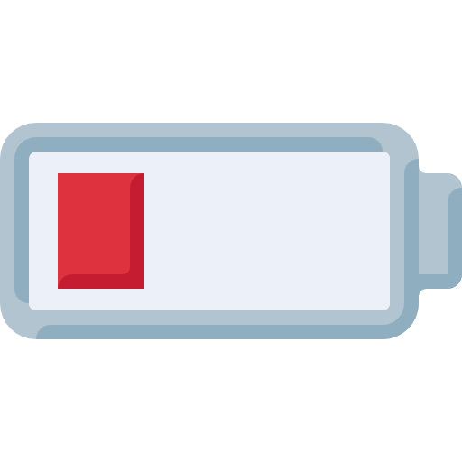
Results
Cells: Device Estimated Power Usage, WiFI Data Transfer
#Text/#Audios In Chat | OnePlus 7T | OnePlus Nord | Mi 10 Lite 5G
10/0 | 0.03%, 0.78Mb | 0.04%, 0.38Mb | 0.05%, 0.68Mb
9/1 | 0.13%, 69.6Mb | 0.06%, 25.52Mb | 0.37%, 67.75Mb
7/3 | 0.34%, 211Mb | 0.22%, 106.11Mb | 1.10%, 225.8Mb
The power consumption increases when #Audios increase!

Slide 22
Further improvements
About Emotion Detection:
We can improve the text classificator gathering more data
We can find a better policy to merge the data coming from the audio and the text classification model
About the power consumption:
We can find a compromise between the audio quality and the user experience to reduce the amount of traffic coming from the devices.

Slide 23
Any Questions?

